Slide 1
Professional Certification Program in Blockchain

Slide 2
CB BC- Fundamentals of Blockchain

Slide 3
Course Introduction

Slide 4
Learning Path

Slide 5
Course Outline
Course Introduction
1
2
Introduction to Blockchain
Blockchain Pillars
3
4
Bitcoin Blockchain
Ethereum Blockchain
5
6
Enterprise Blockchain
Notes:
The six domains covered in this course are:
Course introduction
Introduction to Blockchain
Blockchain Pillars
Bitcoin Blockchain
Ethereum Blockchain
Enterprise Blockchain

Slide 6
Course Components

Slide 7




Course Components
The components of the course are:
Instructor-Led
Training
26 Assisted Practices
5 Knowledge Checks
4 Lesson-End Projects
Notes:
The Fundamentals of Blockchain course includes:
Instructor led training
26 Assisted practices
5 knowledge checks
4 Lesson-end projects

Slide 8
Prerequisites

Slide 9
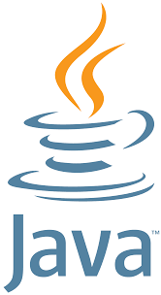
Prerequisites
Please ensure that the fundamentals of Java are clear before taking this course.
Notes:
Here is the prerequisite for this course. Please ensure that the fundamentals of Java are clear before taking this course.

Slide 10
Introduction to Blockchain

Slide 11
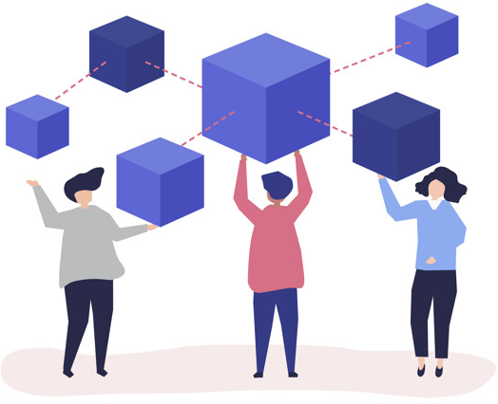
What Is Blockchain?
Blockchain is a digital ledger that is decentralized, distributed, and sometimes public. It consists of a chain of encrypted blocks of data that stores digital records of transactions.
Notes:
Blockchain is a digital ledger that is decentralized, distributed, and sometimes public. It consists a chain of encrypted blocks of data that stores digital records of transactions. It forms a chronological single-source-of-truth for the data.

Slide 12

Why Blockchain?
Digitized workflow automation and management: It aids in the verification and traceability of multistep transactions that require verification and traceability.
Governance and compliance: It has the ability to deliver secure transactions, lower compliance costs, and accelerate data transfer processing.
Auditing and administration: It can aid contract administration and product auditing.
Digital asset management of packaged data: It can also be used to manage titles and deeds, as well as voting platforms.
Notes:
Blockchain helps in the verification and traceability of multi step transactions needing verification and traceability. It can provide secure transactions, reduce compliance costs and speed up data transfer processing.
It aids in the verification and traceability of multistep transactions that require verification and traceability.
It has the ability to deliver secure transactions, lower compliance costs, and accelerate data transfer processing.
It can aid contract administration and product auditing.
It can also be used to manage titles and deeds, as well as voting platforms.

Slide 13



Career Opportunities
Blockchain Developer
Blockchain Solutions Architect
Blockchain Project Manager
They are responsible for developing and maintaining decentralized applications, optimizing blockchain protocols, developing web apps
They have the responsibility of designing, assigning, and connecting components.
They are the head of the project who act as a link between developers and are on point about each project’s scope and ensure that all the client expectations are met.
Notes:
They are responsible for developing and maintaining decentralized applications, optimizing blockchain protocols, developing web apps
They have the responsibility of designing, assigning, and connecting components.
They are the head of the project who act as a link between developers and are on point about each project’s scope and ensure that all the client expectations are met.

Slide 14

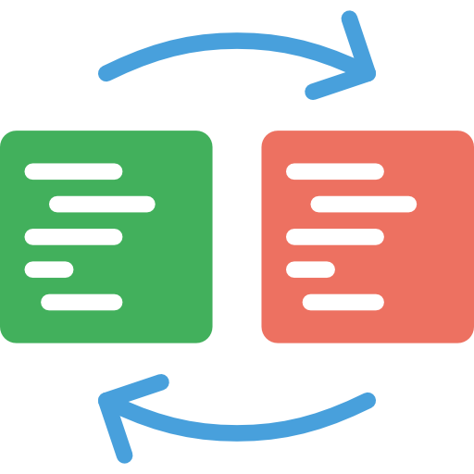

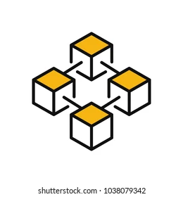
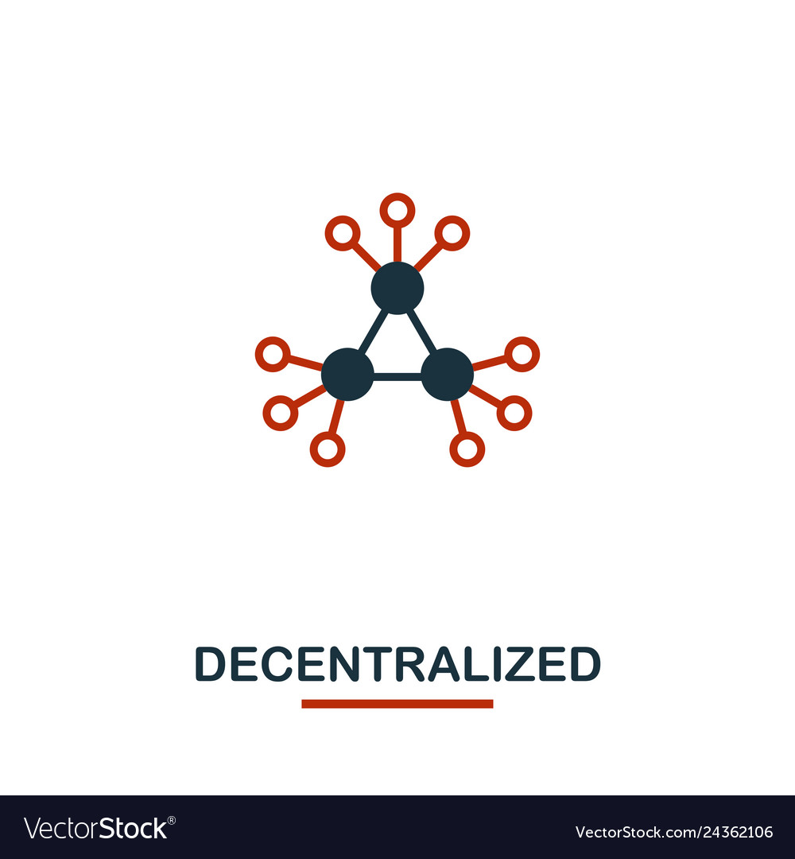
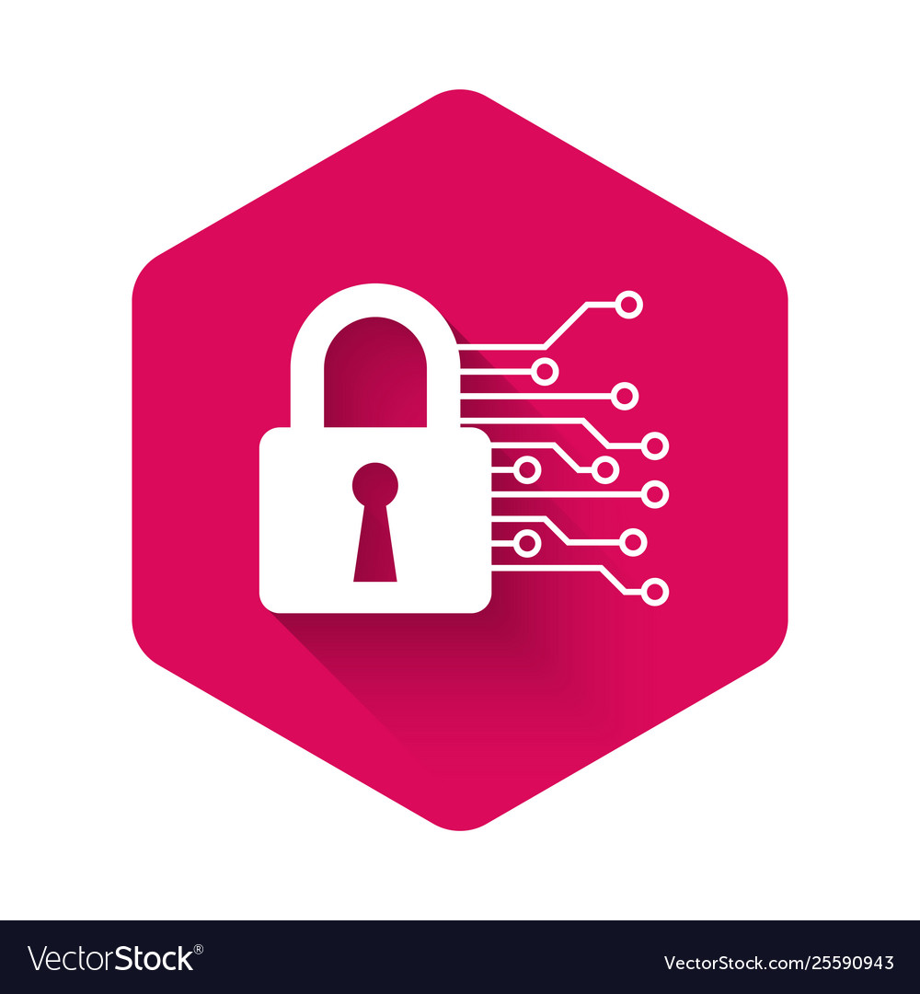
Features of Blockchain
Group Consensus
Immutability
Blockchain
Capacity
Anonymity
Decentralization
Security
Notes:
Some of the main features of Blockchain are: Mining, Anonymity, Decentralized systems, Immutability, High Capacity, and High Security.

Slide 15

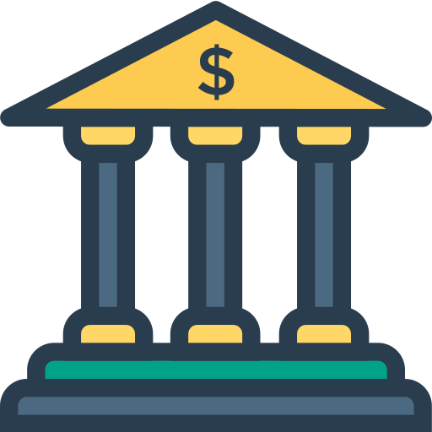

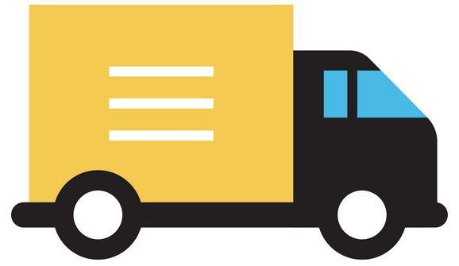



Industries Using Blockchain
Transport and Logistics
Media and Entertainment
Banking and Finance
Healthcare and Life Sciences
Manufacturing
IT and Telecom
Government
Notes:
Blockchain is currently used in various industries. We will look at a few important ones, such as:
Transportation and Logistics, Media and Entertainment, Banking and Finance, Healthcare and Life sciences, Manufacturing, IT and Telecommunications, and Government

Slide 16
Recent Trends in Blockchain

Slide 17
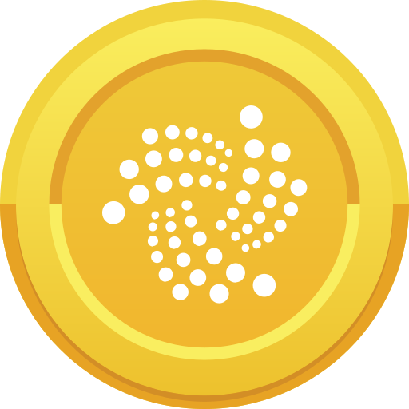
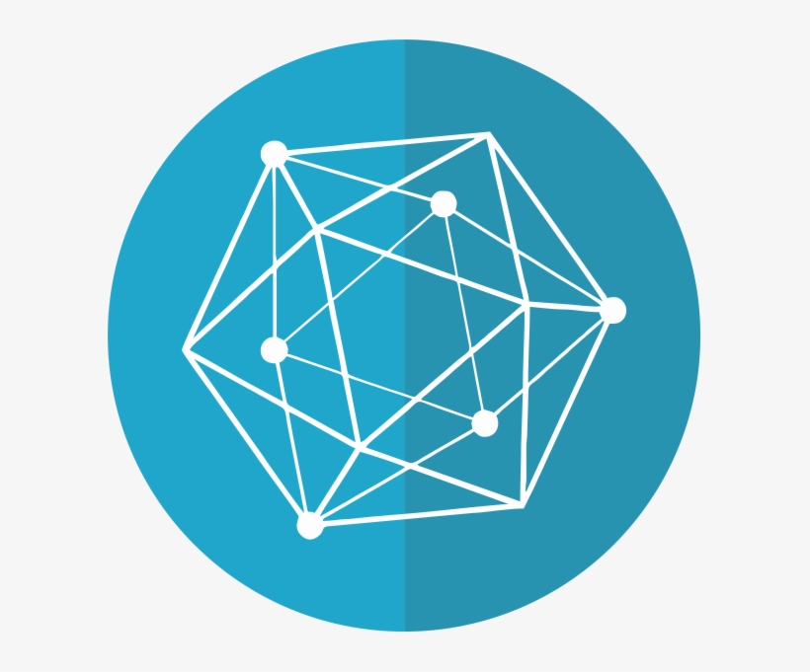
Development of IOTA and Hyperledger
IOTA, together with Hyperledger, is a promising option for standardized applications in the industry.
IOTA
Hyperledger
Global production chains are characterized by transparent supply chains, and companies are increasingly focusing on value generation.

Slide 18
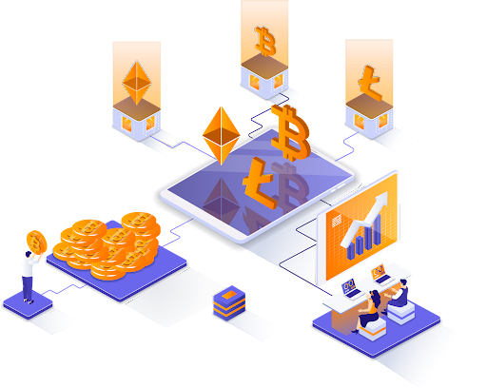
Crypto Exchanges
Decentralized exchanges are the absolute opposite of conventional financial marketplaces. They function confidentially because a user's personal data is only shared with the person they sell to or buy from.
Notes:
Crypto Exchanges come in many forms from centralized custodial options like Coinbase to decentralized
exchanges like Uniswap.

